Slide 1
IBM APPLIED DATA SCIENCE CAPSTONE PROJECT
Akhuemonkhan Esther Elizabeth
27th December, 2025.
Here is where your presentation begins

Slide 2
Table of contents
Executive Summary
Introduction
1
2
Methodology
Results
3
4
Brief discussion on Methodologies and Results of the project
Background, Aim and Problems of the project
Data Collection, Data Wrangling and Data Analysis
Results of statistical analytics.
5
Conclusion

Slide 3
INTRODUCTION
Background of the project, Aim and Problems of the project.
SpaceX Falcon 9 is advertised as the most cost-efficient rocket launch vehicle compared
to other providers, largely due to the fact its first stage boosters are capable of landing
vertically thus allowing the rocket to reuse it’s first stage.
By accurately estimating the probability of a successful booster landing, the associated
launch cost can be more reliably inferred upon, providing valuable information and data
for companies competing against SpaceX during contract bids.
The project aims to predict the successful landing of the SpaceX Falcon 9 first stage.
Problems:
What are the key operational, environmental and design factors that influences and determines the likelihood of the SpaceX Falcon 9 first stage successful landing?.
How can machine learning techniques be applied to model and predict the landing outcome of the Falcon 9 based on various historical launch data?
Which predictive modeling approach provides the most accuracy in forecasting landing success?
How should the data set be reprocessed, engineered and validated to ensure reliable model performance and minimize bias?

Slide 4
METHODOLOGY
Summary of Methodology; This project employs an exhaustive approach to predicting the successful landing of the SpaceX Falcon 9 first stage. The methodology includes data collection, processing, exploratory analysis, interactive visualization and predictive modeling.
Data Collection Methodology:
Web Scraping
Data was sourced from Wikipedia, providing historical information about the SpaceX Falcon 9 launch vehicle.
SpaceX API
Additional data was sourced through the SpaceX API which supplied detailed records of launches, including launch dates, boosters informations and launch site locations.
Data Wrangling:
Data cleaning includes handling missing values, hot encoding, standardization, maintenance of consistency, removing irrelevant columns.

Slide 5
METHODOLOGY cont.
Exploratory Data Analysis: Visualization and SQL
Interactive Visual Analysis
Use of Folium in generating interactive maps.
Development of plotly dash application to analyze launch success rates.
EDA with SQL to derive insights and answer questions regarding data sets
Visualizations of launch success rate, launch sites, payloads through scatter graphs , bar charts using Seaborn and Matplotlib
Machine Learning Predictive Analysis Using Classification Models
Train data, test and split data and data normalization
Parameter tuning to maximize accuracy of predictive models
Evaluation of Models

Slide 6
Data Collection
Step 1: SpaceX API Request
Initiate API Request
Fetch Launch Data
Store Data Locally
Step 2: Web Scraping Wikipedia
Request HTML table from Wikipedia
Parse Data indicating all relevant tables
Convert to data frame and Export to CSV. format
STEP 1: GitHub URL: jupyter-labs-spacex-data-collection-api.ipynb
STEP 2: GitHub URL: jupyter-labs-webscraping.ipynb

Slide 7
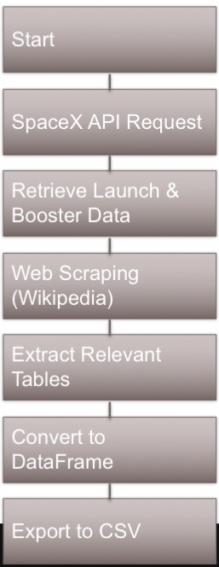
Data Collection Flow Chart

Slide 8
Data Wrangling
Perform EDA on Dataset
Calculate number of launches done at each launch site
CAPSTONE-PROJECT/blob/main/labs-jupyter-spacex-Data%20wrangling.ipynb
Calculate the number and occurrence of each orbit
Create a landing outcome label from outcome column
GitHub URL: labs-jupyter-spacex-Data%20wrangling.ipynb

Slide 9
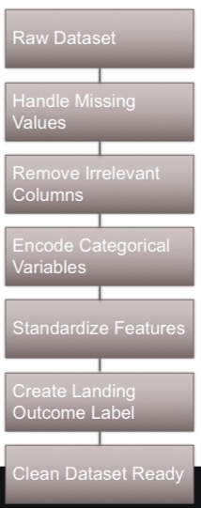
Data Wrangling Flow Chart

Slide 10

EDA with Data Visualization
Overview; The EDA involves visually imploring and summarizing the datasets to enable us understand the distribution of data, identify patterns in the dataset and discover the relationship if any between the data sets.
EDA Visualization includes:
Histograms
Bar Charts
Line Charts
Scatter Graphs
GitHub URL: https://github.com/Teee11/IBM-APPLIED-DATA-edadataviz%20(3).ipynb

Slide 11

EDA with SQL
SQL Queries performed on the DataSet
Calculated total number of launches indicating successful and failed launches.
Calculation of success rates in relation to launch site and rocket model.
Combination of datasets for comprehensive analytics
Filtering data to focus on specific launch outcomes (Success/failure).
Conditions that affect launches like launch date, rocket configuration and payload mass carried by boosters.
Identification of outliers.
GitHub URL: jupyter-labs-eda-sql-coursera_sqllite.ipynb

Slide 12

Predictive Analysis Method
Load Dataset into Dataframe
Set parameters and algorithims
Split data into training sets and test set
Building the model
Selection of Machine learning algorithims
Normalization of Data Set
Fit data sets
GitHub URL::SpaceX_Machine%20Learning%20Prediction_Part_5.ipynb

Slide 13
Predictive Analysis Method cont.
Model Evaluation
Calculation of Accuracy for each model with test sets
Plot confusion
Selection of best predictive model

Slide 14
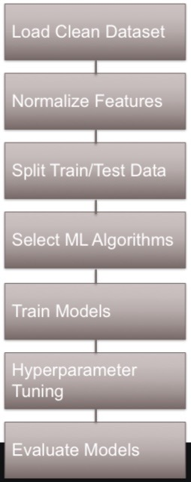
Predictive Analysis Method Flow Chart

Slide 15
Results
EDA with visualization results
EDA with SQL results
Interactive Map with folium results
Analytical Results

Slide 16
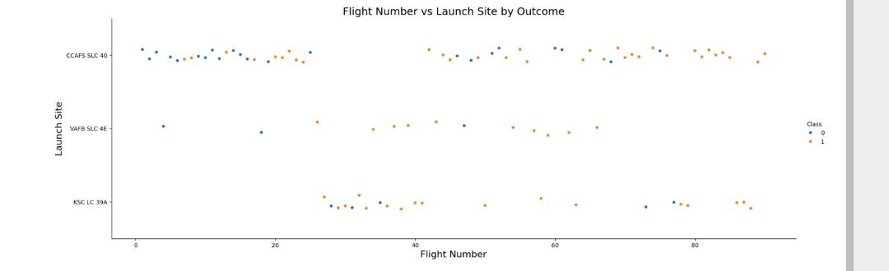
Visualization Results with EDA
Flight Number vs Launch Site
Variable Outcomes recorded at the Launch Sites shows that various factors not limited to the launch site itself affects the level of success of landing.

Slide 17
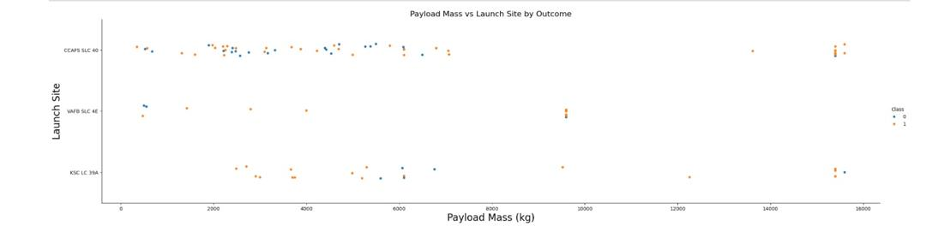
Visualization Results with EDA
Payload vs Launch Site
Our review shows that CCAFS SLC 40 mostly handles payload mass less than 10,000kg while the KSC LC 39A handled payload mass well above 15,000kg making it efficient for high capacity launches .

Slide 18
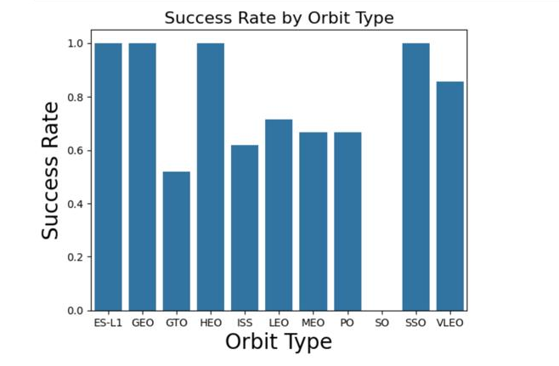
Visualization Results with EDA
Success Rate vs Orbit Type
ES-L1, GEO, HEO, SSO have the highest levels of success rate while an average rate occurs between VLEO, ISS, LEO, MEO, PO. SO is recorded to have no success rate.

Slide 19
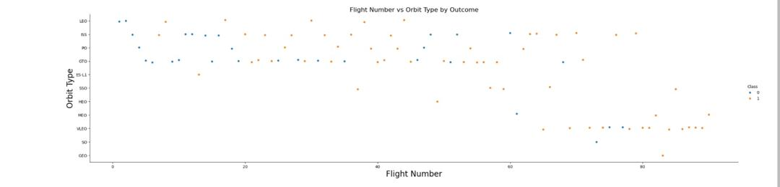
Visualization Results with EDA
Flight Number vs Orbit Type
We observed that with increased number of launches the success rate improved significantly highlighting the effect of experience and knowledge.

Slide 20
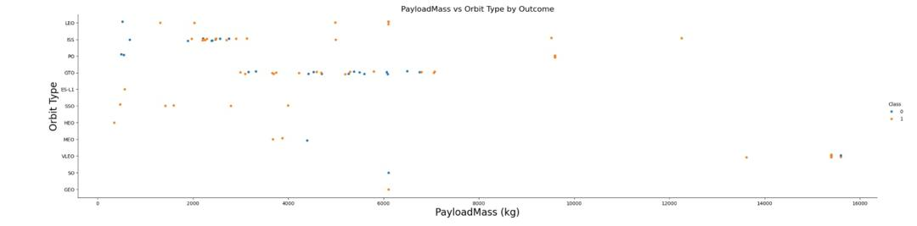
Visualization Results with EDA
Payload vs Orbit Type
We observed successful landings across all except so where payload mass is less than or equal to 6,000kg, in cases where payload exceeded this threshold we experienced a number of variable outcomes.

Slide 21
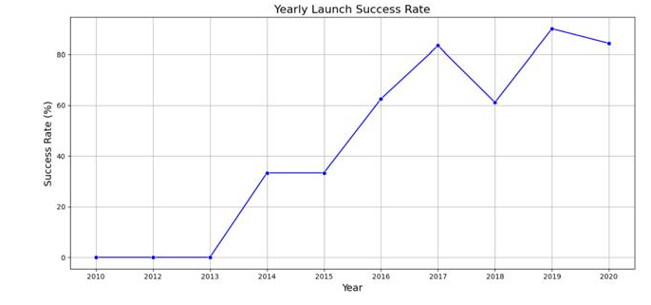
Visualization Results with EDA
Launch Yearly Success Rate
We observed year on year improvement in the success rates of launches since 2013 regardless of the dip in 2018 to 60% from 80% in 2017.

Slide 22
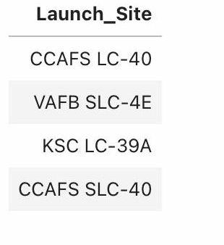
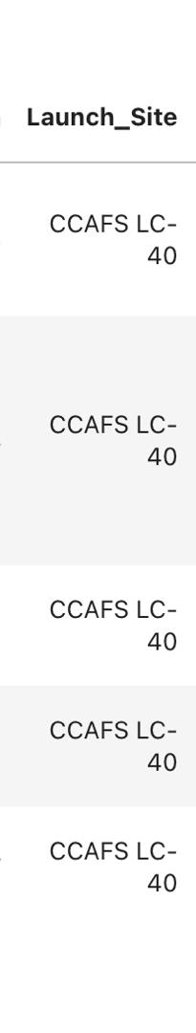
SQL Results with EDA
All Launch Sites Names
Launch Sites names begin with CCA

Slide 23
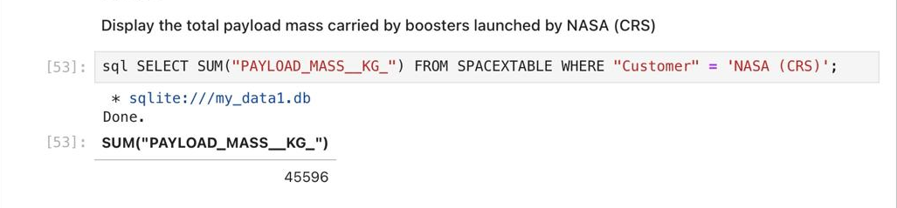
SQL Results with EDA
Total Payload Mass

Slide 24
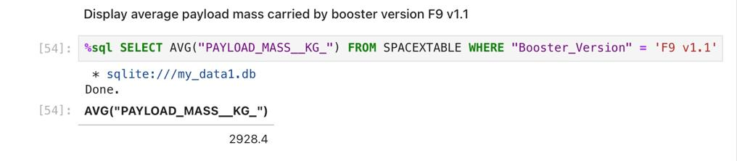
SQL Results with EDA
Average Payload Mass

Slide 25
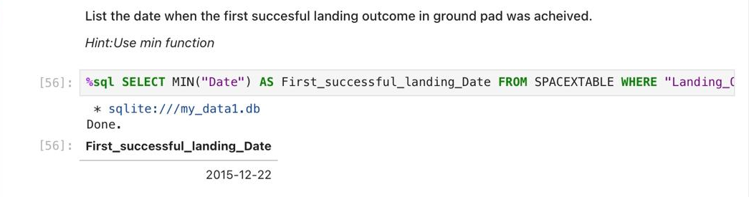
SQL Results with EDA
First Successful Ground Landing Date

Slide 26
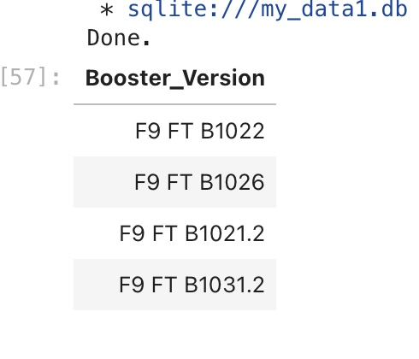
SQL Results with EDA
Names of boosters that successfully landed on a drone ship and carried a payload between 4000kg and 6000kg

Slide 27
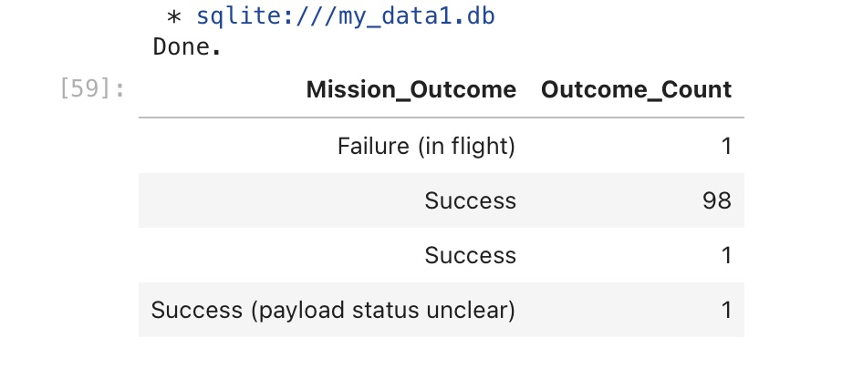
SQL Results with EDA
Total Number of Successful and Failure Mission Outcomes

Slide 28
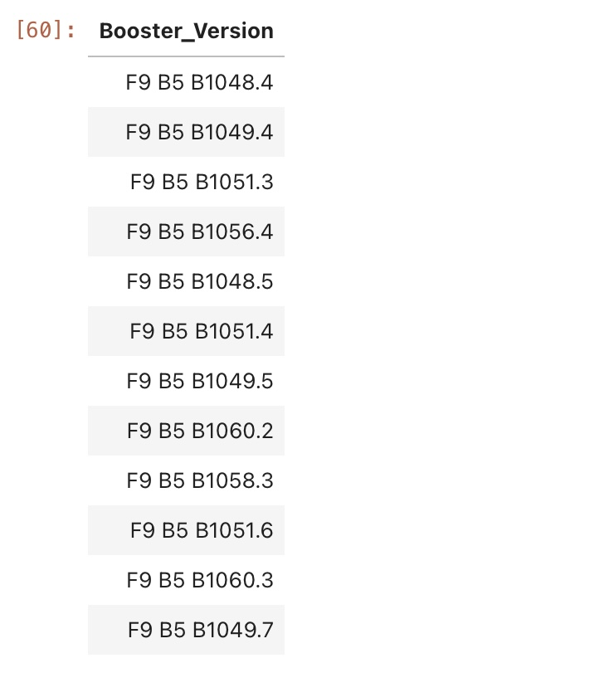
SQL Results with EDA
List of booster versions with the maximum recorded payload capacity

Slide 29
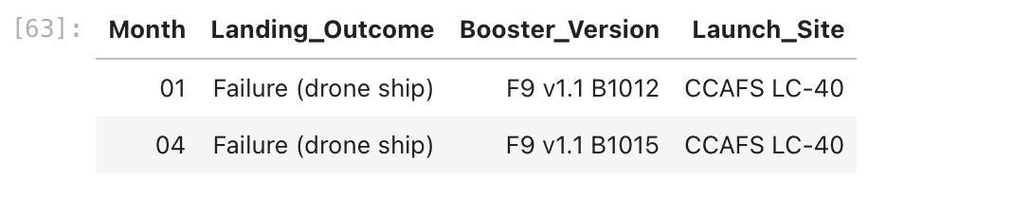
SQL Results with EDA
2015 Launch Records

Slide 30
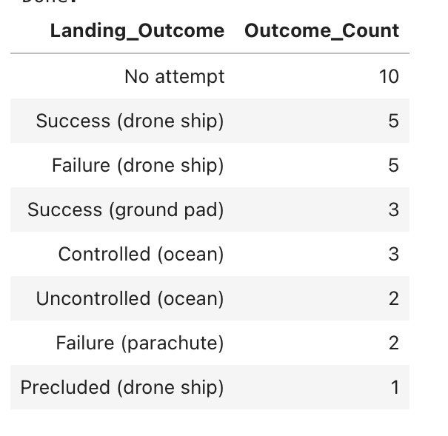
SQL Results with EDA
Number of landing outcomes recorded between 2010-06-04 and 2017-03-20

Slide 31
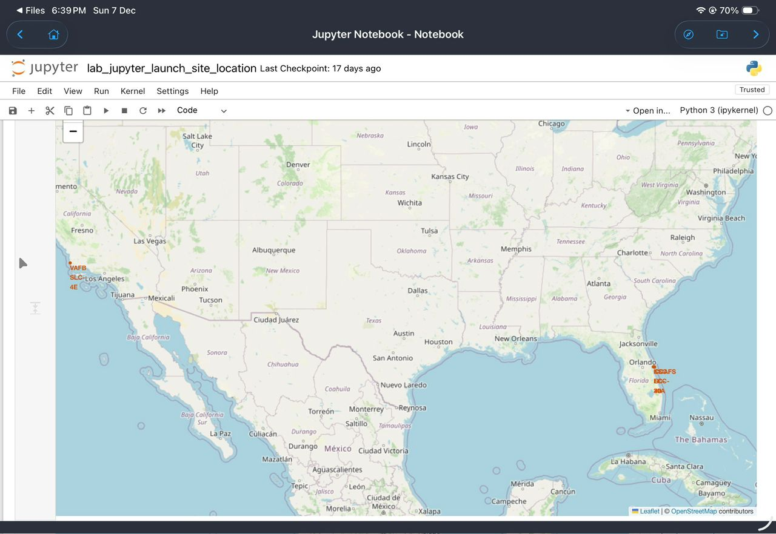
Interactive map with Folium Results
All Launch Sites Displayed
The Launch sites are seen to be located near the Los Angeles and Florida coasts.

Slide 32
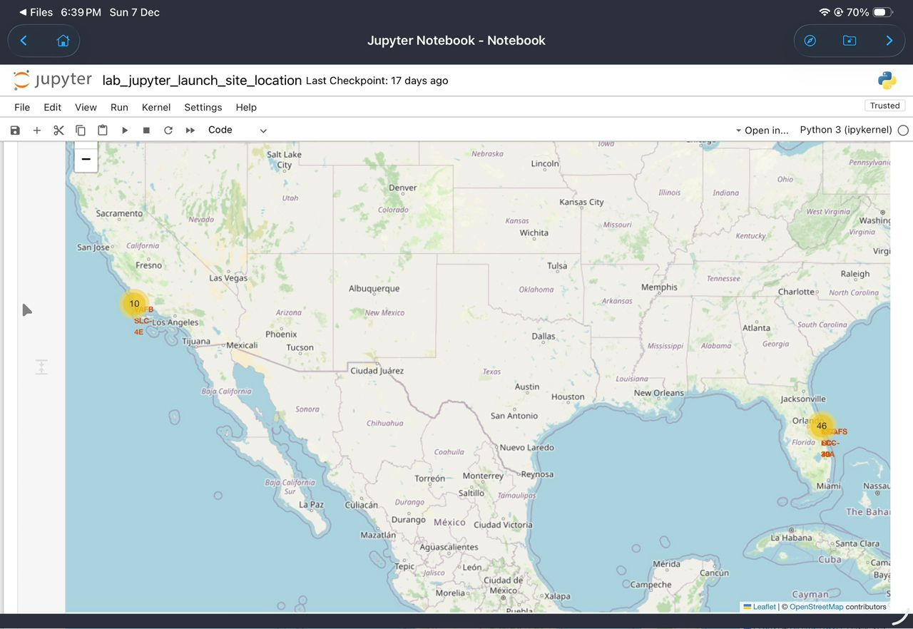
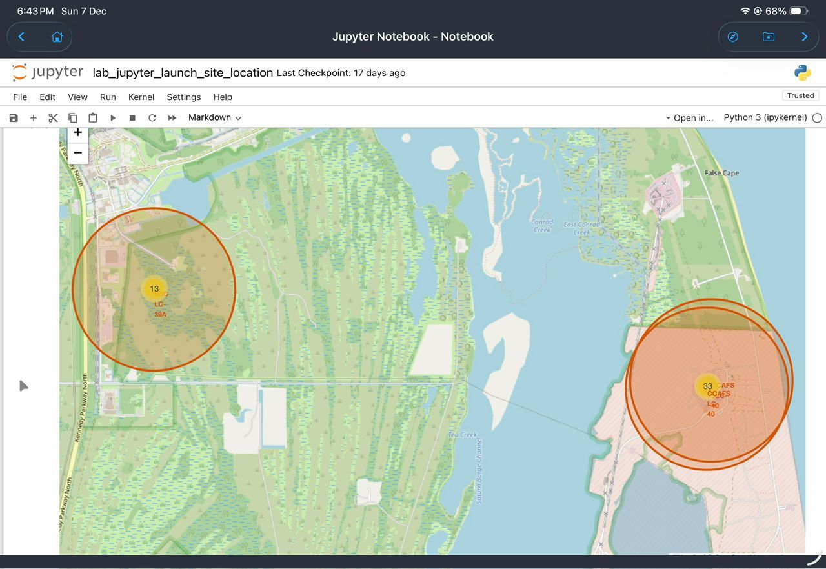
Marked Success/Failed Launches at sites
GitHub URL: lab_jupyter_launch_site_location.ipynb

Slide 33
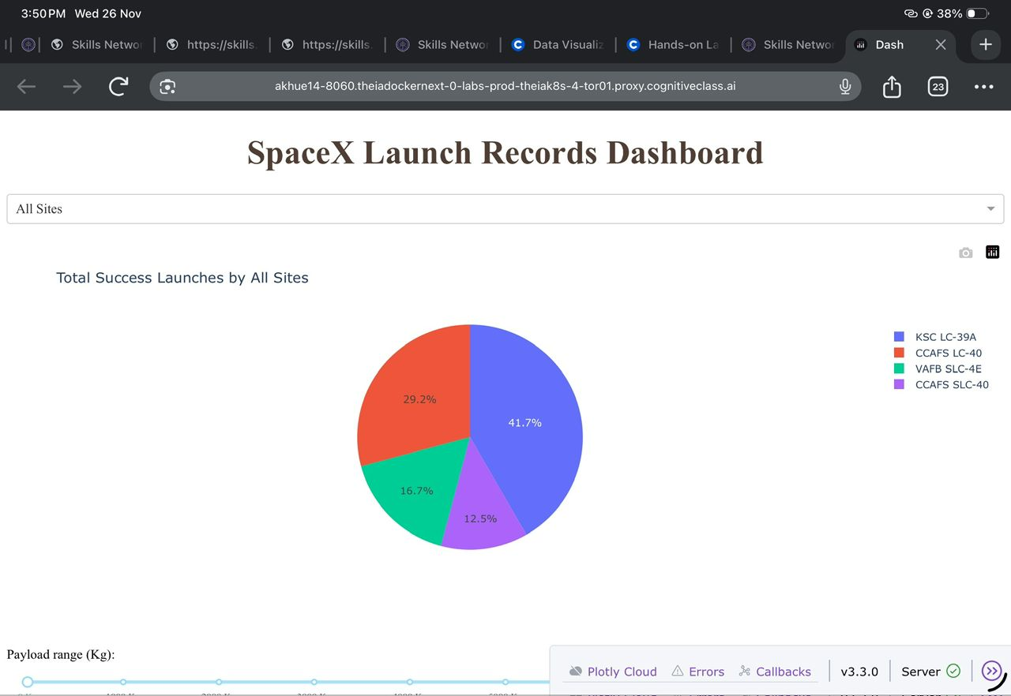
Dashboard Results
Key Findings
KSC LC-39A; 41.7%*
CCAFS LC-40; 29.2%
VAFB SLC-4E; 16.7%
CCAFS SLC-40; 12.5%
KSC LC-39A is the site with the largest number of successful launches.
GitHubURL: spacex_dash_app.py

Slide 34
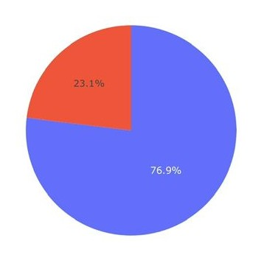
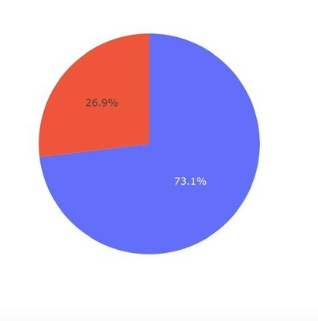
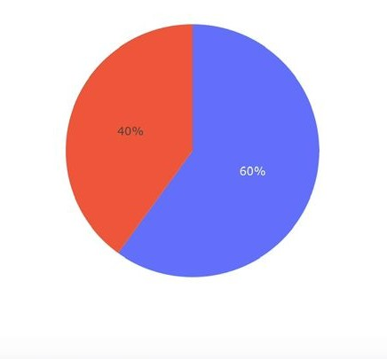
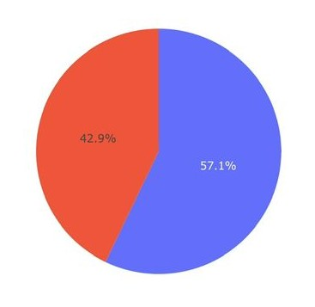
Total successful / failed launches at each site
Success
Failure
KSC LC-39A
CCAFS LC-40
VAFB SLC-4E
CCAFS SLC-40
KSC LC-39A has the highest success launch rate. This rate (76.9%) highlights the effectiveness and reliability of KSC LC-39A site.

Slide 35
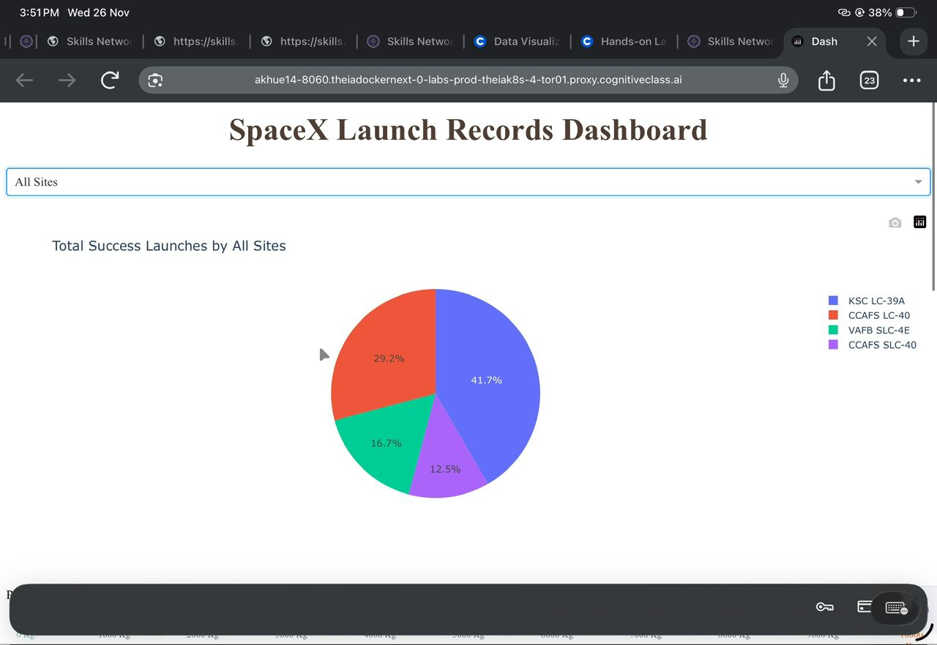
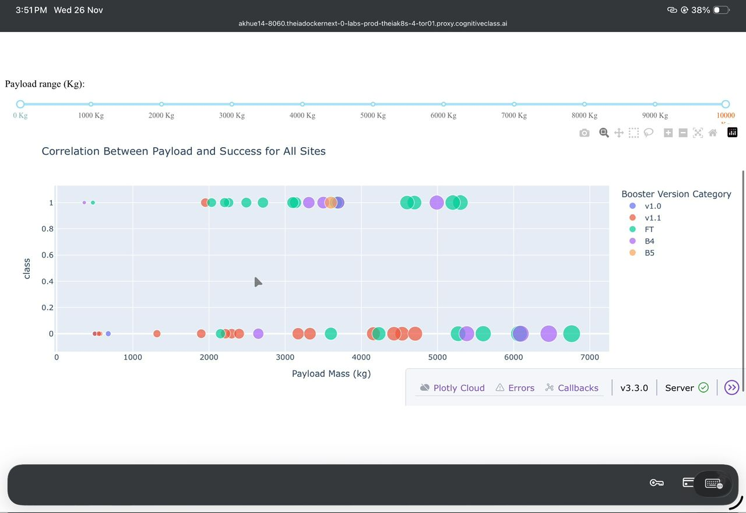
Insights from SpaceX Launch Data Dashboard
Launch Success Rates;
KSC LC-39A has the highest rate of 41.7%
This indicates that KSC LC-39A is the most reliable among the various launch sites evaluated.
CCAFS LC-40, VAFB SLC -4E, CCAFS SLC-40, are 29.2%, 16.7% and 12.5% respectively indicating a high level of variability of success in launches across these different sites.
Booster Version Performance;
Booster Version FT: The chart indicates this is the most frequently used with a high degree of success across various payloads masses.
Booster Version 1.0: It can be seen that it has a fewer launches and requires further evaluation to clearly understand its performance .
There is no clear trend to relate how the performance of booster versions and higher payloads correlates with lower landing success rates.
KSC LC-39A
CCAFS LC-40
VAFB SLC-40
CCAFS SLC-40

Slide 36
Predictive Analysis

Slide 37
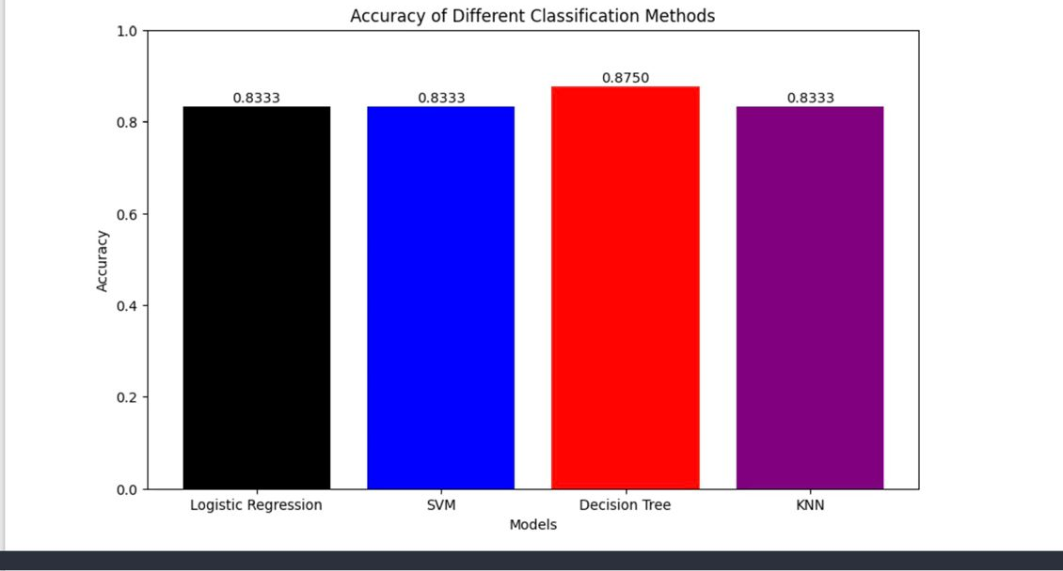
Classification Accuracy
The results show that the Decision Tree has the highest classification accuracy on the test data, with an accuracy rating of 0.8750. This indicates that Decision Tree is the most suited for analyzing the dataset in comparison to Logistic Regression, SVM, and KNN which all achieved an equal accuracy of 0.8333.
KSC LC-39A
CCAFS LC-40
VAFB SLC-40
CCAFS SLC-40

Slide 38
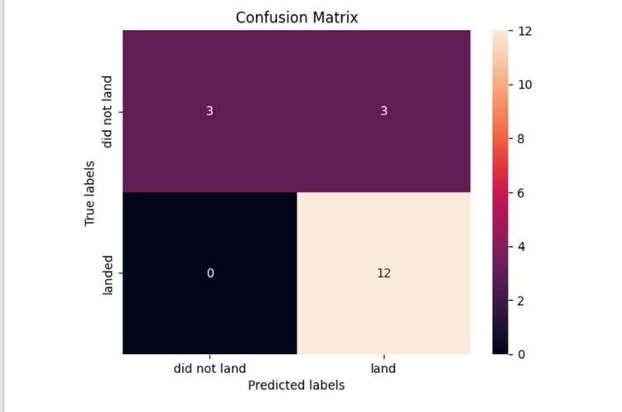
Confusion Matrix
Insights to the Model
Accuracy Rating; The model achieved a rating of 87.50% with an sufficient number of true positives and negatives, demonstrating substantial effectiveness in predicting the First stage landing of Falcon 9 space ships
Absence of False Negatives; The model revealed no false negatives in predicting the success of landing. This indicates reliability of the model and is crucial for safety in aerospace operations.
False Positives: The model produced 3 false positives indicating the over preparation of the model makes the model performance acceptable for practical applications.
Balanced Performance; The model has revealed a balanced performance with a bias towards successful landings prediction.
KSC LC-39A
CCAFS LC-40
VAFB SLC-40
CCAFS SLC-40

Slide 39
Conclusions
Launch Success Rates;
KSC LC-39A has the highest rate of 41.7%
This indicates that KSC LC-39A is the most reliable among the various launch sites evaluated.
Booster Version Performance;
Booster Version FT: The chart indicates this is the most frequently used with a high degree of success across various payloads masses.
There is no clear trend to relate how the performance of booster versions and higher payloads correlates with lower landing success rates.
Predictive Analysis;
Comprehensive Analytics of the data revealed Decision Tree had the highest accuracy rating for analyzing the data set of 0.8750 in comparison to the 0.8333 of the other models.
The model produced a sufficient and balanced performance in relation towards the prediction of successful landings and it revealed zero false negatives.
KSC LC-39A
CCAFS LC-40
VAFB SLC-40
CCAFS SLC-40

Slide 40
Thank You!
KSC LC-39A
CCAFS LC-40
VAFB SLC-40
CCAFS SLC-40

